Slide 1
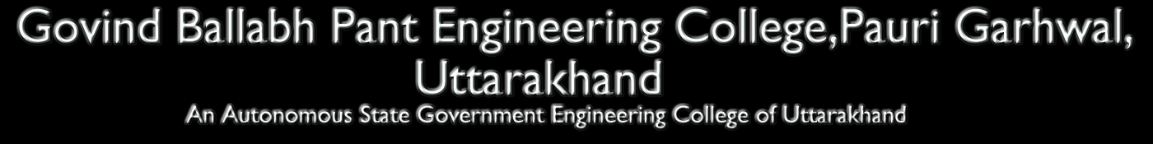

Speaker Recognition Using MFCC and TDA
Supervisor: Mr. Ramesh Kumar
Brij Mohan Purohit 08090101014
Arjun Joshi 08090101009
Ankur Bharti 08090101007
Ashish Mathur 08090101010

Slide 2
Overview
Introduction.
Main principles of speaker recognition.
Selected Method.
Speaker recognition Models.
Feature Extraction.
Feature Extraction Implementation.
Conclusion.

Slide 3
Introduction
Speech is the process of automatically recognizing a certain word spoken by a particular speaker based on individual information in speech voice.
Design and implement an automatic voice recognition system.

Slide 4
Main principle of Speaker Recognition
Identification
Verification

Slide 5
Speaker Recognition methods
Text Dependent :
For speaker identity is based on his/ her speaking one or more specific phase.
Text Independent:
Speaker models capture characteristics of somebody’s speech which show up irrespective of what one is saying.

Slide 6
Selected Method
Text Independent:
  Identify the person who speaks regardless to what is saying.

Slide 7
Speaker recognition Models
Feature Extraction
Feature Matching

Slide 8
Speech Feature Extraction
That extracts a small amount of data from the voice signal that can later be used to represent each speaker.
MFCC: is based on the known variation of the human ear’s critical bandwidths with frequency, filters spaced linearly at low frequencies and logarithmically at high frequencies.

Slide 9
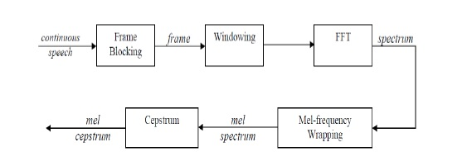
Feature extraction steps

Slide 10
Implementation of ASR by using two approaches:
MFCC Approach
Time Domain Analysis

Slide 11
MFCC approach
Mel-frequency cepstrum (MFC) is a representation of short term power spectrum of a sound, based on a linear cosine transform of a log power spectrum on a nonlinear mel scale of frequency
MFCCs are the coefficient that collectively make up an MFC
In MFC, the frequency bands are equally spaced on the mel-scale which approximates the human auditory system more closely than the linearly spaced

Slide 12
frequency bands used in normal spectrum
MFCCs are commonly derived as
Take the fourier transform of a signal (windowed)
Map the powers of obtained signal on to mel-scale, using triangular over lapping windows
Take the logs of the power at each of the mel frequencies
Take the discrete cosine transform of mel powers
The MFCCs are the amplitudes of resulting spectrum

Slide 13
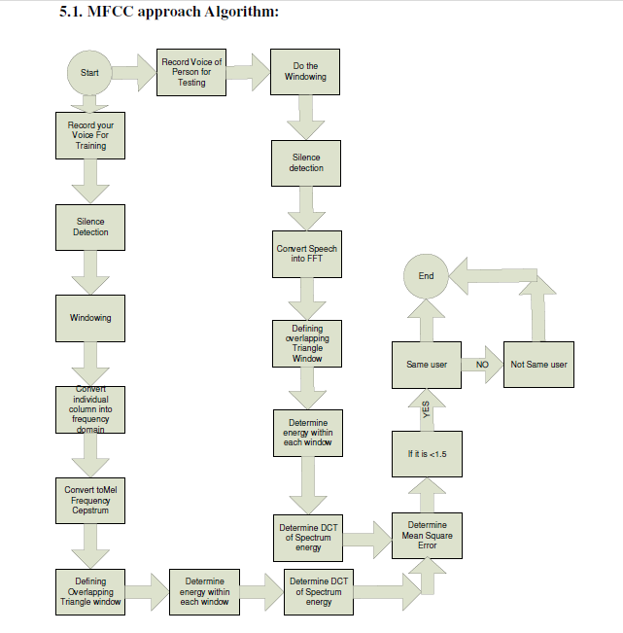

Slide 14
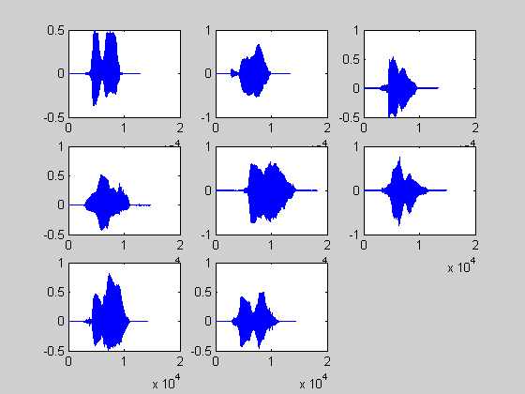
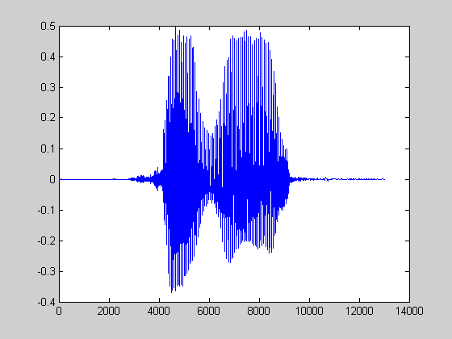
Input Speech Signals
‘ze’
‘ro’
There are silence at the beginning and at the end of the signals.
The word consists of two syllables.

Slide 15
Frame Blocking
Continuous
speech
Frame
Blocking
frame
Windowing
FFT
spectrum
Cepstrum
Mel-frequency
wrapping
Continuous speech signal is blocked into frames of N samples with adjacent frames being separated by M(M<N).
Frame1 Consist of First N samples.
Frame2 Begins M samples after first frame, and the overlaps it by N-M samples.
Frame3 Begins 2M samples after the first frame, and the overlaps it by N-2M samples.

Slide 16
Frame Blocking
Continuous
speech
Frame
Blocking
frame
Windowing
FFT
spectrum
Cepstrum
Mel-frequency
wrapping
Continuous speech signal is blocked into frames of N samples with adjacent frames being separated by M(M<N).
Frame1 Consist of First N samples.
Frame2 Begins M samples after first frame, and the overlaps it by N-M samples.
Frame3 Begins 2M samples after the first frame, and the overlaps it by N-2M samples.

Slide 17
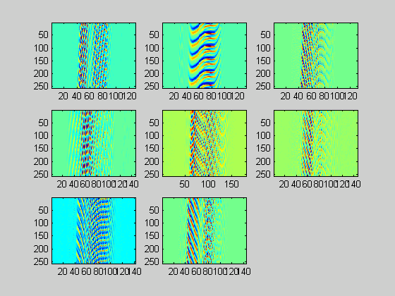
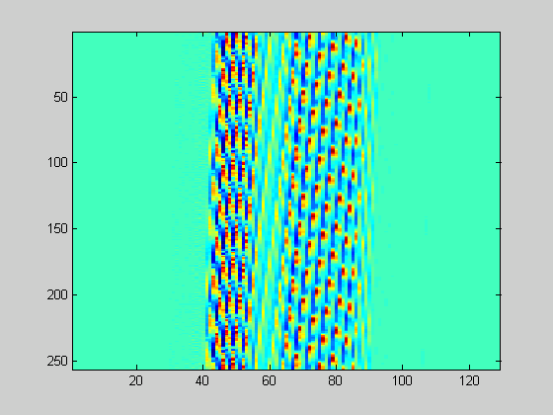
After Frame Blocking
The speech signals were blocked into frames of N samples with overlap.

Slide 18
Windowing
Continuous
speech
Frame
Blocking
frame
Windowing
FFT
spectrum
Cepstrum
Mel-frequency
wrapping
Each individual frame will be windowed.
Hamming window is used in this project.

Slide 19
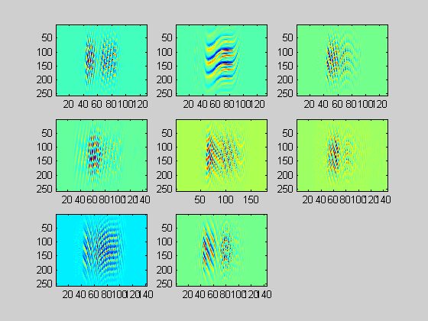
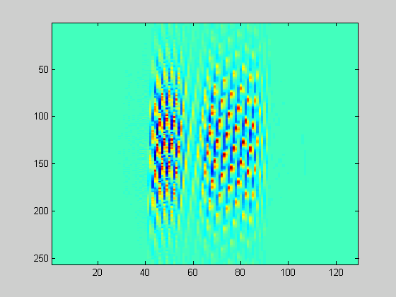
After Windowing

Slide 20
Before Windowing After Windowing

Slide 21
Fast Fourier Transform
Continuous
speech
Frame
Blocking
frame
Windowing
FFT
spectrum
Cepstrum
Mel-frequency
wrapping
Convert each frame of N samples form time domain into the frequency domain.

Slide 22
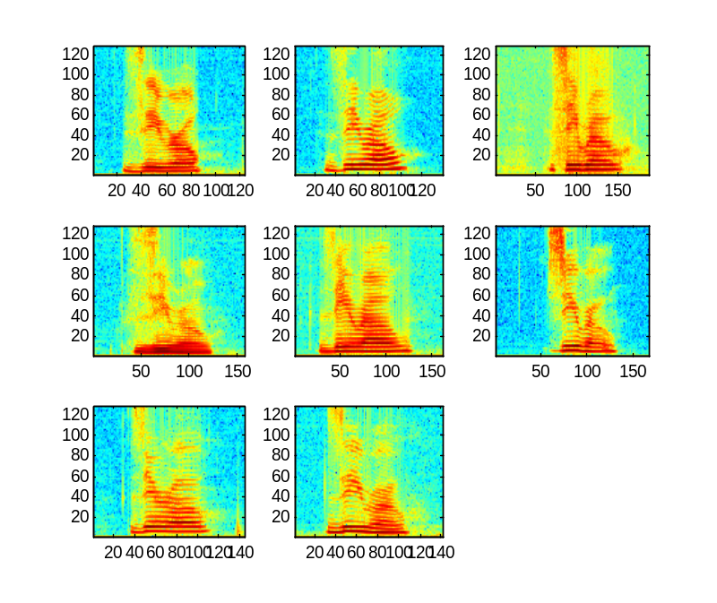
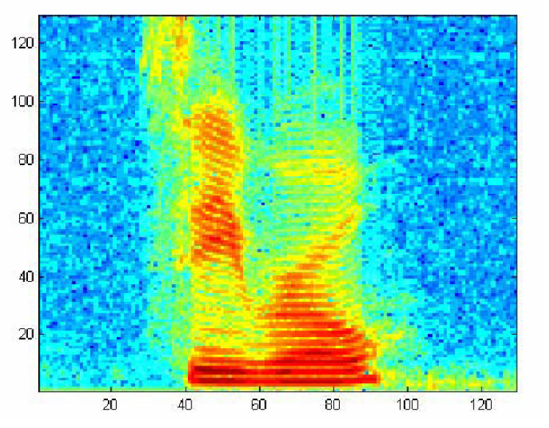
Log Scale of S1 speech wave

Slide 23
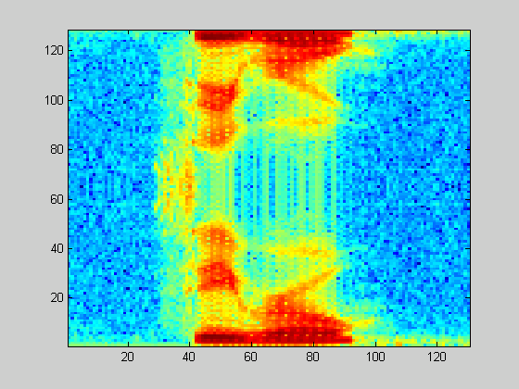
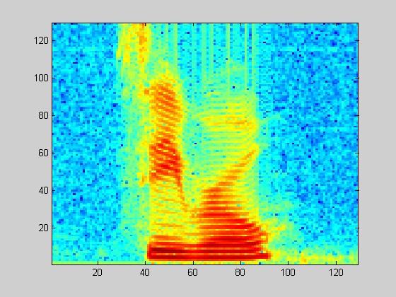
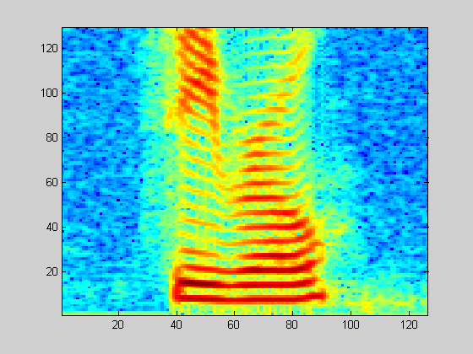

Slide 24
Mel-Frequency Wrapping
Continuous
speech
Frame
Blocking
frame
Windowing
FFT
spectrum
Cepstrum
Mel-frequency
wrapping
Mel frequency scale is a linear frequency spacing below 1KHz and a logarithmic spacing above 1KHz.
Filter Bank.

Slide 25
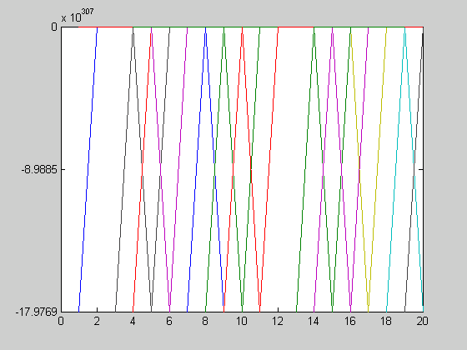
Mel –Spaced Filter Bank

Slide 26
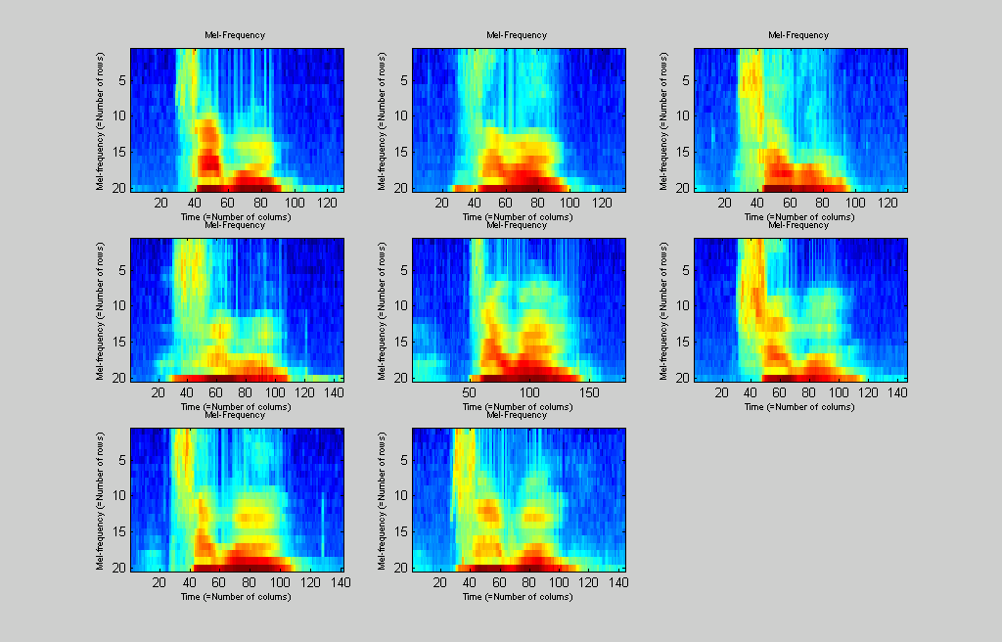
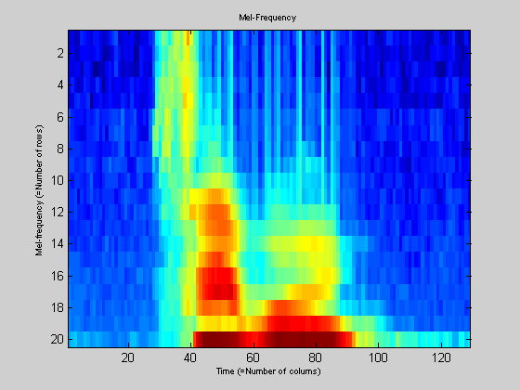
Mel-Frequency Wrapping

Slide 27
Before Mel-Frequency wrapping After Mel-Frequency wrapping

Slide 28
Cepstrum
Continuous
speech
Frame
Blocking
frame
Windowing
FFT
spectrum
Cepstrum
Mel-frequency
wrapping
Convert the log mel spectrum back to Time domain.

Slide 29
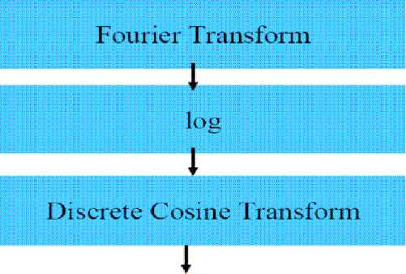
Take the logs of the power at each of the mel frequencies
Take the discrete cosine transform of mel powers
The MFCCs are the amplitudes of resulting spectrum

Slide 30

Time Domain Analysis

Slide 31
Advantages
The systems can easily be used remotely by telephone or by handicapped persons.
Voice recognition systems are also ideal for blind or visually impaired users
No typing of data is needed
Non intrusive, High social acceptability
It is a quite cheap technology.

Slide 32
Disadvantages
The main disadvantage is that even the best speaker recognition system can make errors
A persons voice can easily be recorded & can be used for unauthorized PCs or networks
Recognition of word is slow
Not suitable to be used in noisy places
Software must be trained to recognize specialist or technical words

Slide 33
Applications
There are three main areas where speaker
recognition can be used-
Authentication- It allows the users to identify themselves using their voices. This can be very much convenient than traditional means of authentication like carrying key or remembering password etc.
Forensic- Proving the identity of a recorded voice can convict a criminal or discharge innocent

Slide 34
Surveillance- Security agencies uses speaker recognition as a filter for finding relevant information from collected information to recognize the targeted speakers that are of interest for service
Other applications are-
Time & attendance system
Access control system
Biometric login
Security for confidential information
Telephone Banking/broking

Slide 35
Scope
This project focused on “Isolate word recognition” but idea can be extended to “Continuous word recognition” & create Language Independent Recognition system
Use of statistical models like HMMs, GMMs or learning models like Artificial Neural Network can also enhance the present project. And make system much tolerant & less error prone

Slide 36
Challenges
The main challenge is that its hard to develop a highly efficient speaker recognition system
Many challenges affects its accuracy. This includes poor quality voice samples, variability in speakers voice due to illness, moods, changes over time & noise in environment.
Large scale-speaker identification problem is also quite hard to handle. As number of speakers increases, doing an exhaustive

Slide 37
match through whole population becomes almost computationally implausible.
Its hard to identify two person having similar vocal characteristics.

Slide 38
Conclusion
Goal of this project is to create speaker recognition system
Unknown speaker is identified by matching extracted features of their speech with the stored extracted feature in database
Feature extraction is done by using MFCC & speaker is modelled by Vector Quantization

Slide 39
VQ codebook is generated by clustering the feature of vectors of each speaker & stored in database
Distortion measure based on minimum Euclidean distance is used in recognition stage
During this project, We found that Vector based clustering approach provides faster identification than using only MFCC or FFT approach

Slide 40
Queries??

Slide 41
Thanks!

